Slide 1
Fraud Detection Using Machine Learning
Behavior-Based Risk Modeling & Financial Impact Analysis
Tools Used: Python (Jupyter), XGBoost, Streamlit, Power BI

Slide 2
Agenda
Digital financial fraud leads to significant monetary losses.
  Challenges:
    Fraud cases are rare but high impact.
    Fraud patterns change over time.
    Manual review increases operational cost.
Objective:
Build a machine learning model to detect fraud accurately and reduce financial losses.

Slide 3
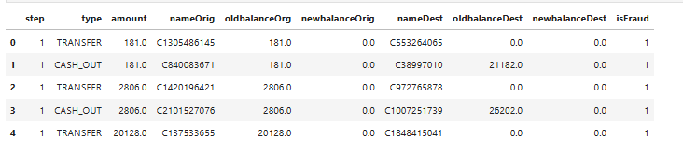
Dataset Overview
The dataset contains:
    Transaction type (CASH_IN, TRANSFER, etc.)
    Transaction amount
    Old and new account balances
    Fraud label (0 = Legitimate, 1 = Fraud)
The dataset is highly imbalanced, with very few fraud cases compared to legitimate transactions.

Slide 4
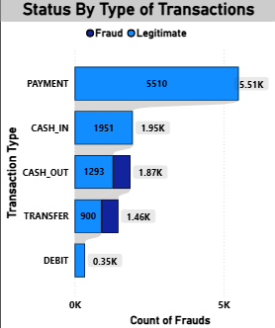
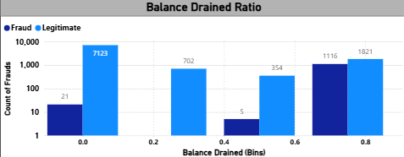
Exploratory Data Analysis
Key Insights:
    Fraud mostly occurs in TRANSFER and CASH_OUT transactions.
    Fraud transactions often drain a large percentage of account balance.
    Higher transaction velocity increases fraud probability.
    Large amount-to-balance ratio is a strong fraud indicator.

Slide 5
Feature Engineering
Created behavioral features:
    Balance Drain Percentage
    Transaction Velocity (1h / 24h)
    Amount-to-Balance Ratio
    Rapid Drain Flag
    Risk Score (probability-based)
These features help the model understand fraud behavior patterns.

Slide 6
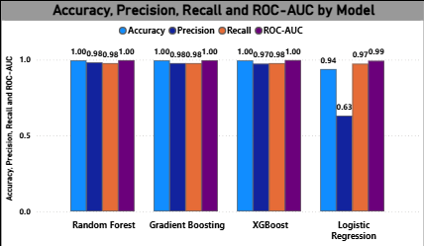
Model Selection
Models Tested:
  Logistic Regression
  Random Forest
  Gradient Boosting
  XGBoost
XGBoost delivered the best performance based on accuracy, precision, recall, and ROC-AUC.

Slide 7
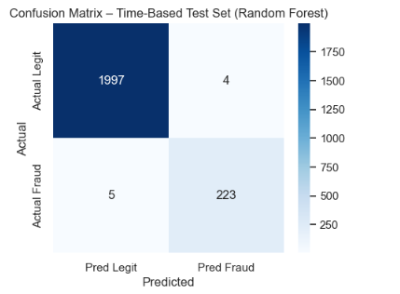
Model Performance
Key Metrics:
  Accuracy: ~99%
  Precision: High
  Recall: High
  ROC-AUC: Close to 1
The model successfully detects most fraud cases while keeping false alarms controlled.

Slide 8
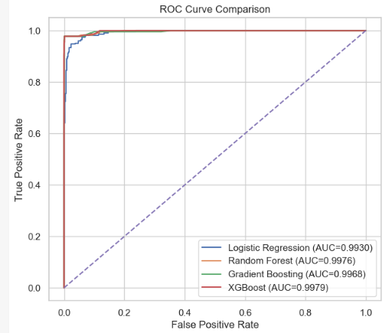
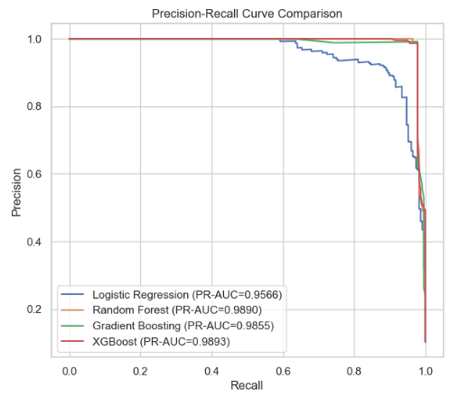
ROC & PR Analysis
ROC curve shows strong class separation.
Precision-Recall curve confirms stability under imbalanced data.

Slide 9
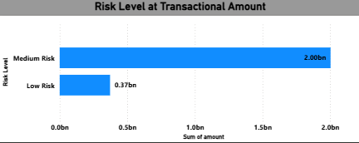
Risk Scoring System
Instead of simple classification, the model assigns a fraud probability (0 to 1).
Risk Categories:
    Low Risk (< 0.30)
    Medium Risk (0.30 – 0.60)

Slide 10
Power BI Dashboard Overview
Dashboard Pages:
  Dataset Overview
  Fraud Behavior Analysis
  Model Performance
  Business & Financial Impact
The dashboard transforms model output into business insights.

Slide 11
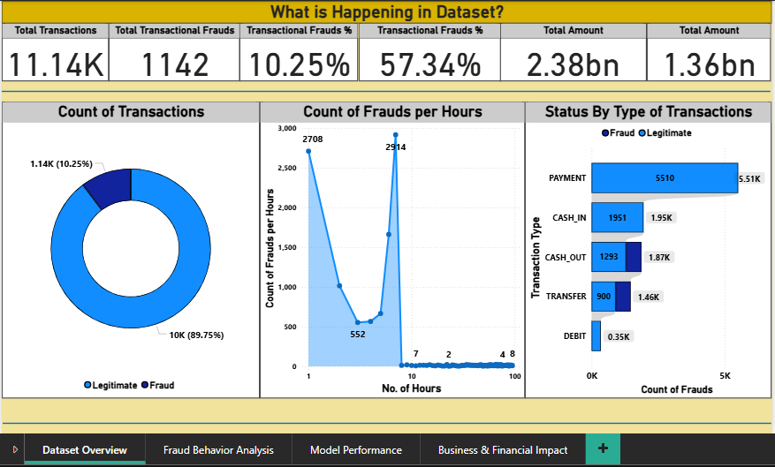

Slide 12
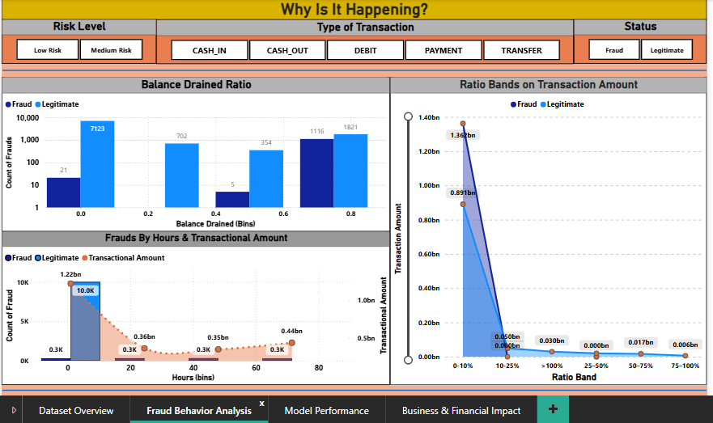

Slide 13
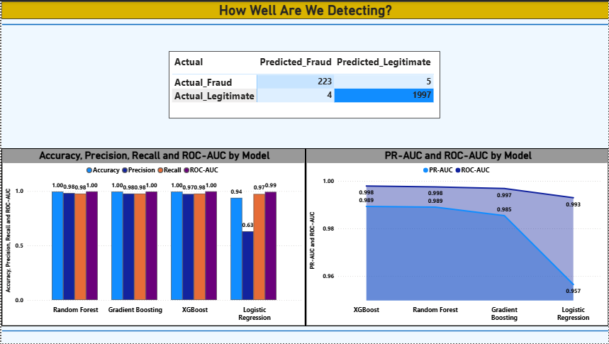

Slide 14
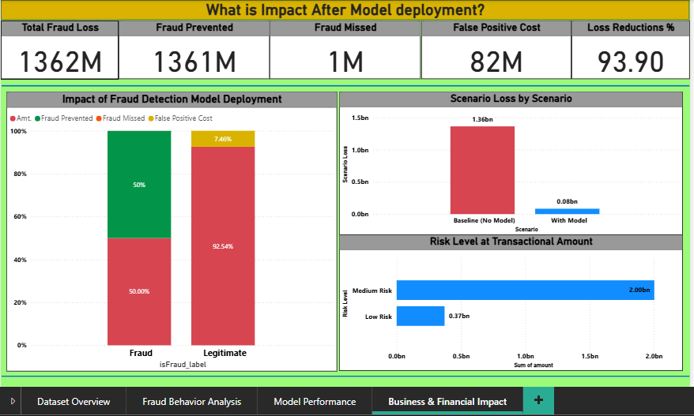

Slide 15
Business Value
The model:
  Reduces financial losses significantly.
  Improves fraud detection accuracy.
  Enables risk-based transaction monitoring.
  Minimizes unnecessary transaction blocking.

Slide 16
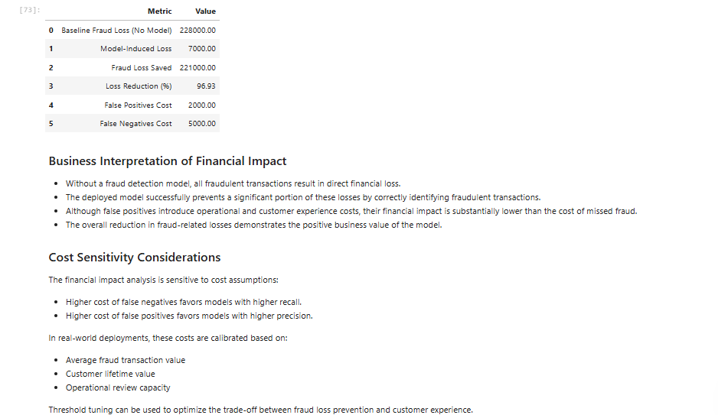

Slide 17
Deployment
The model was deployed using Streamlit.
Users can:
    Enter transaction details
    Get real-time fraud probability
    View risk classification instantly

Slide 18
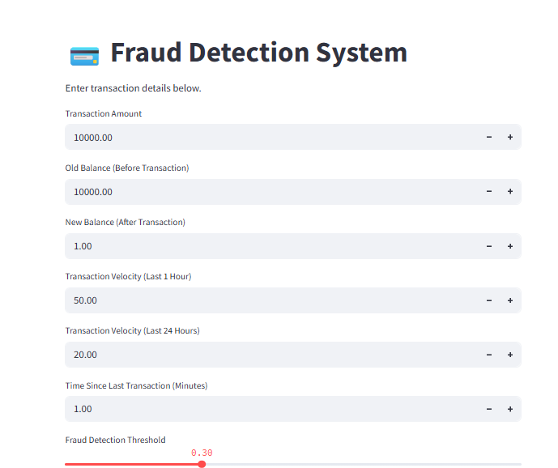

Slide 19
Conclusion
The fraud detection system:
    Accurately detects fraudulent transactions
    Uses behavioral insights for prediction
    Reduces financial risk
    Provides real-time risk scoring
This project bridges technical modeling and business impact.

Slide 20
Questions ?

Slide 21
Thank You!

